Slide 1
Connecting Sensors to Arduino
2016. 09. 01.
Jinhyuk Yim (jinhyuk@uns.ajou.ac.kr)
Eungkyu Lee (eungkyu@uns.ajou.ac.kr)

Slide 2
Arduino Sensors
Sensor type
Sensor Programming
Temperature and Humidity sensor
PIR sensor
Ultrasonic sensor
Practice

Slide 3
Arduino Sensors

Slide 4
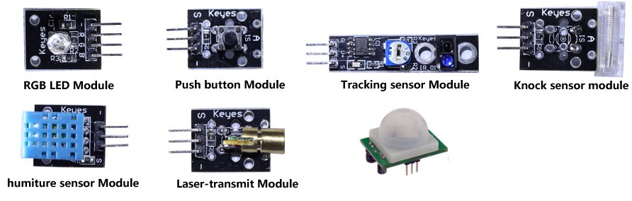
Various Sensors
Arduino can be utilized to connect a variety of sensors.
PIR sensor Module

Slide 5
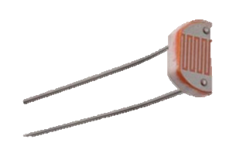
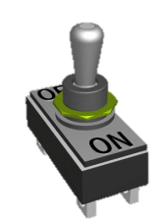
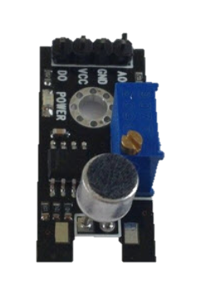
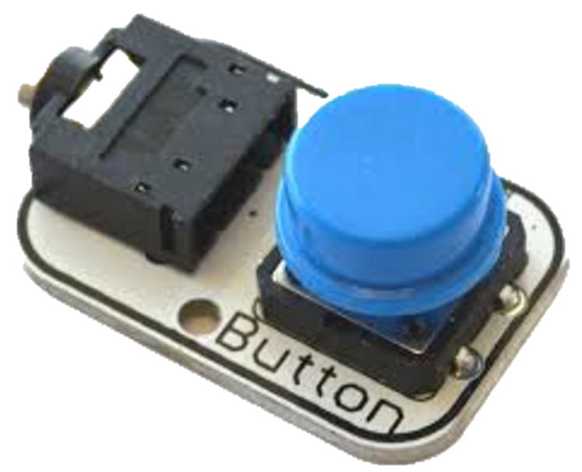

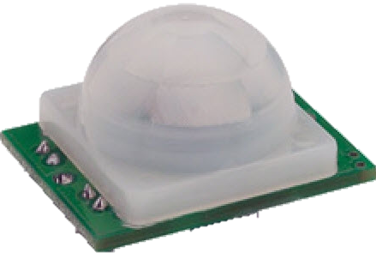
Sensor Type – Analog/Digital (1/2)
Sensors are usually classified into two – analog & digital
Analog – infinite possibilities, continuous data (e.g., sound, smell, etc.)
Digital – finite, discrete data (e.g., infrared, switch, button, etc.)
Analog Sensor | Digital Sensor
Light sensor | Switch
Sound sensor | Button
Pressure sensor | Infrared sensor

Slide 6
Sensor Type – Analog/Digital (2/2)
However, some sensors operate in both way
Accelerometer, temperature
Analog sensors have fixed data reading rate by the manufacturer
Users can configure data reading rate in digital sensors by using IC

Slide 7
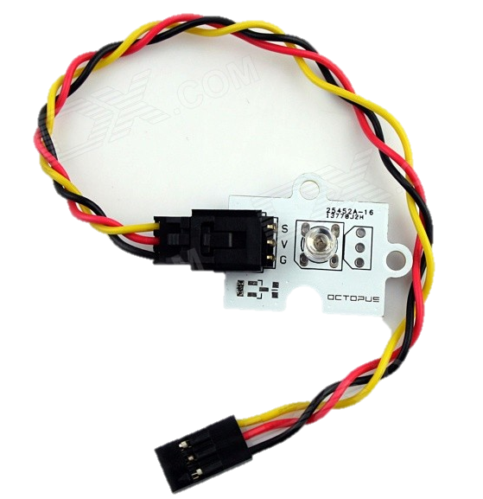
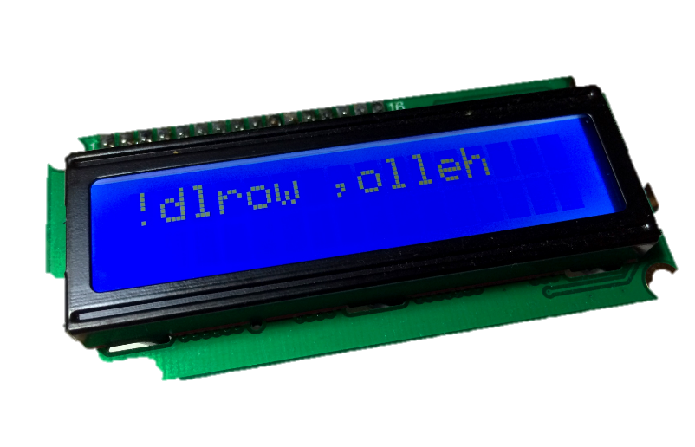
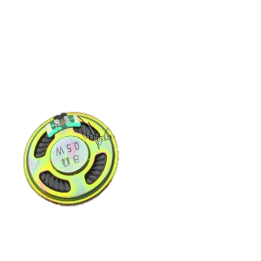
Sensor Type – Input/Output
Furthermore, we can classify the sensors into another way – Input & Output
Input – switch, button, pressure, sound, etc.
Output – LED, text LCD, etc.
Input Sensor | Output Sensor
Switch | LED
Button | Text LCD
Pressure sensor | Speaker

Slide 8
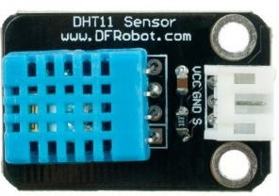
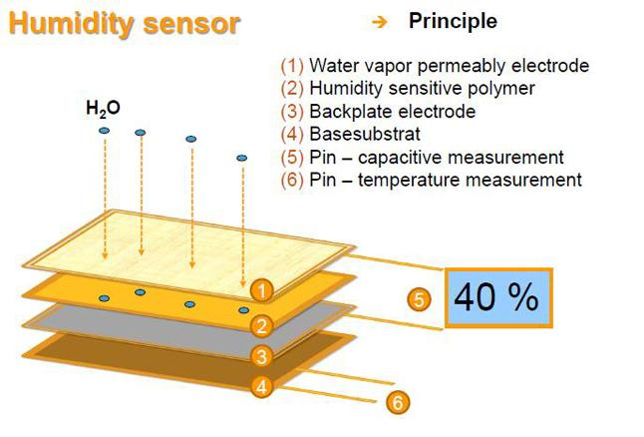
Arduino sensor specification
Temperature and humidity sensor
Low-cost digital temperature and humidity sensor
20-80% humidity readings with ± 5% accuracy
0-50 °C temperature readings ±2°C accuracy

Slide 9
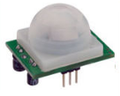
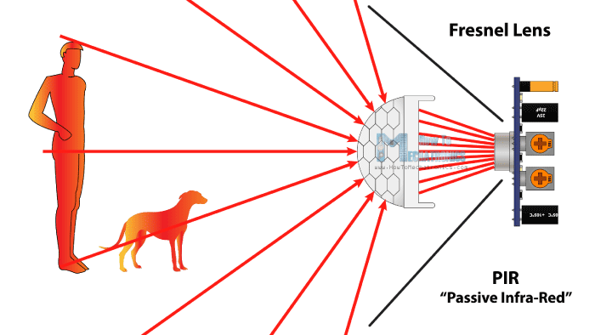
Arduino sensor specification
PIR sensor (Passive Infrared Sensor)
Detection distance is 2cm~450cm
High precision up to 3mm

Slide 10
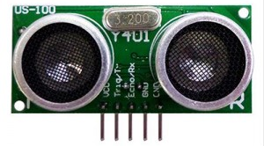
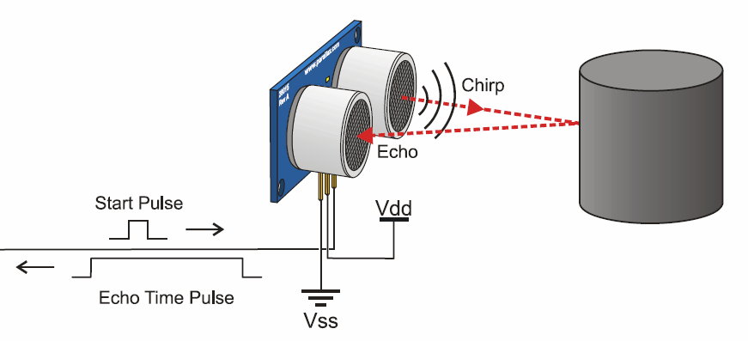
Arduino sensor specification
Ultrasonic sensor
Distance range is 20mm~3500mm
Serial baud rate is 9600

Slide 11
Sensor Programming

Slide 12
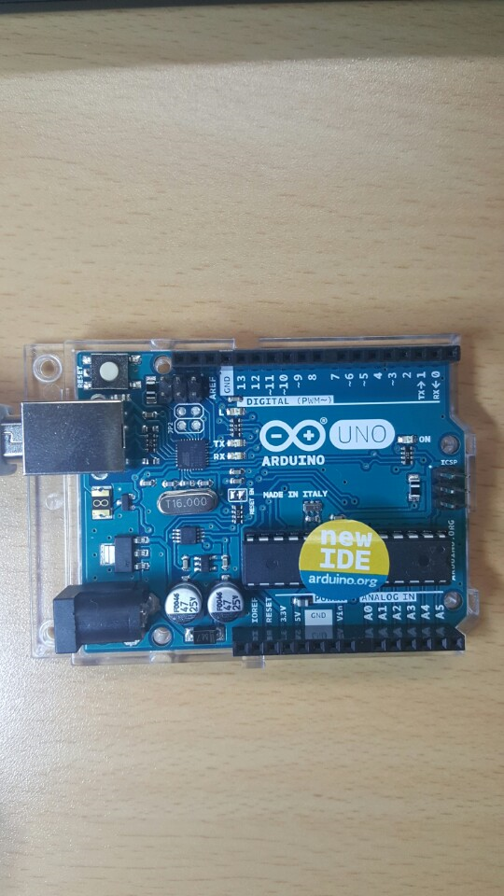
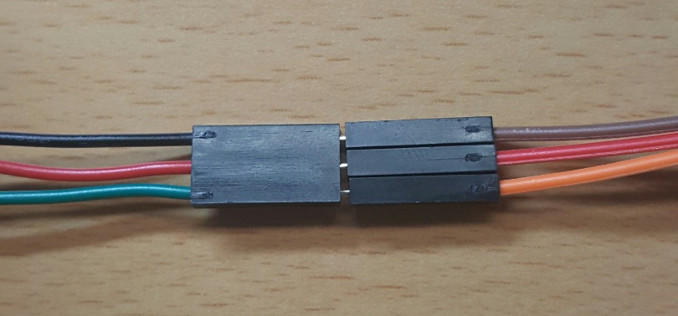
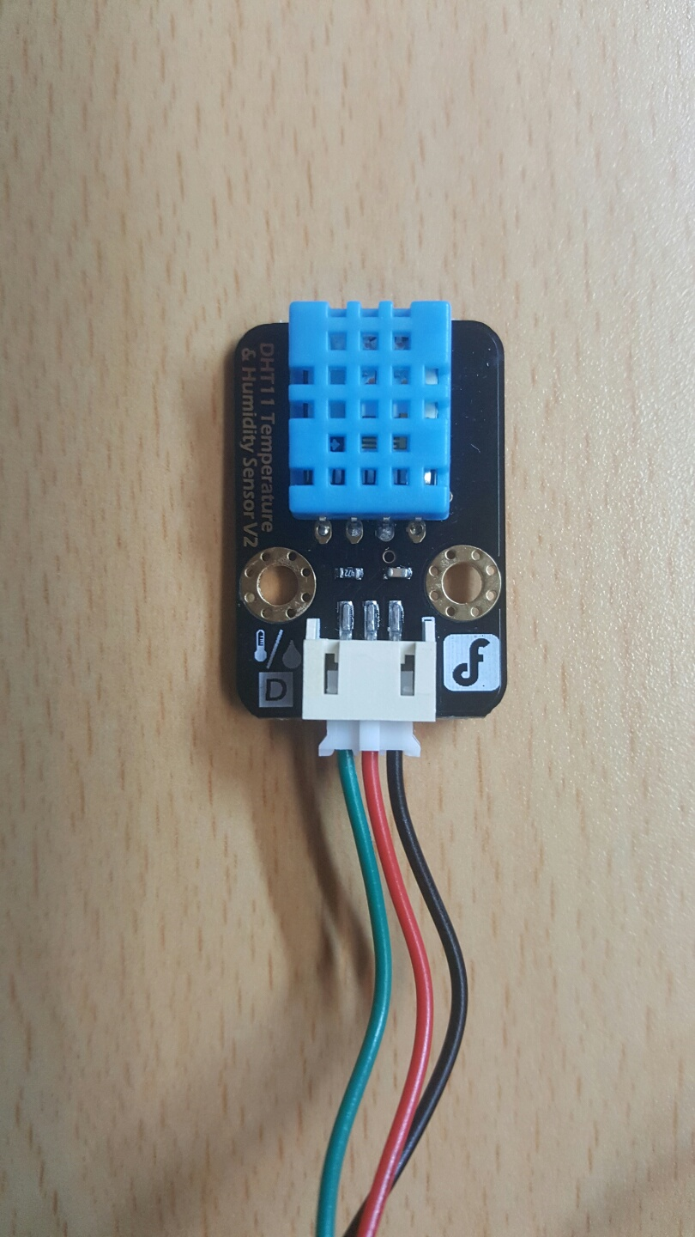
Temperature/Humidity Sensor
Checking temperature and humidity
Step 1: Copy DHT11 folder to Arduino libraries folder
C:\Users\ (AccountName) \Documents\Arduino\libraries
Step 2: Import library
Sketch -> Import library -> Add library
Step 3: Connect the sensor to Arduino
Voltage : 5v
Step 4: Checking temperature and humidity
Tools -> Serial Monitor
Ground
Voltage
Signal

Slide 13
Temperature/Humidity Sensor Datasheet
Product Type : DHT11
Temperature Measurement Range : 20-90%RH
Humidity Measurement Range : 0-50 °C
Humidity Accuracy : ± 5% RH
Temperature Accuracy : ±2 °C
Body size : 15.5mm x 12mm x 5.5mm
Operating volt : 3 – 5v

Slide 14
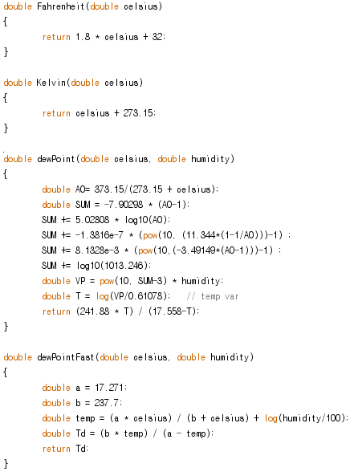
Code Example – Temperature/Humidity Sensor (1/2)
Functions for calculate a temperature and humidity
Temperature
Fahrenheit
Fahrenheit is a temperature scale based on one proposed in 1724 by the physicist Daniel Gabriel Fahrenheit
Kelvin
The kelvin is a unit of measure for temperature based upon an absolute scale.
Humidity
Dew Point
the temperature at which a given concentration of water vapor in air will form dew
Dew Point Fast

Slide 15
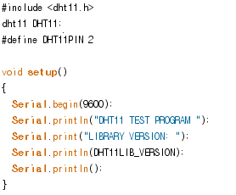
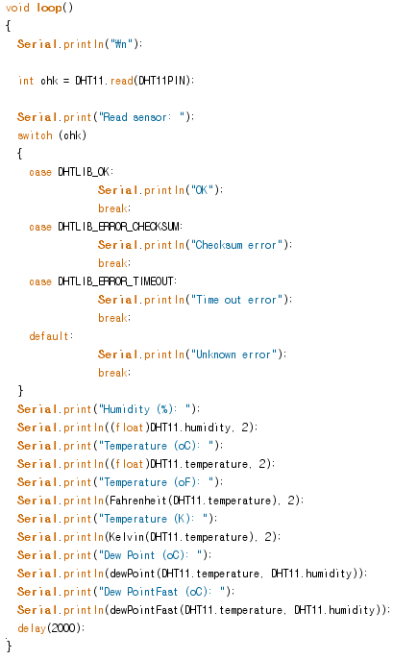
Code Example – Temperature/Humidity Sensor (2/2)

Slide 16
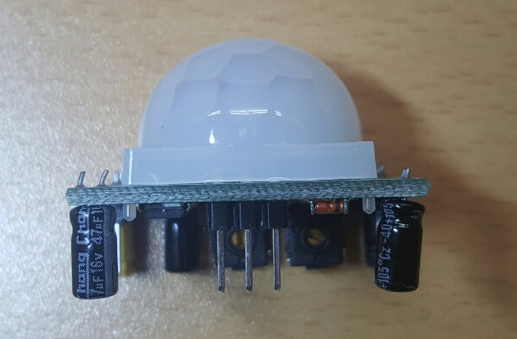
PIR sensor (Passive Infrared Sensor)
Human body detection sensor
It allow you to sense motion.
Usually it used to detect whether a human has moved in or out of the sensors range.
How to use a PIR sensor
Step 1: connect the sensor to Arduino
Voltage : 5v
Step 2: Checking detection result
Tools -> Serial Monitor
Ground
Signal
Voltage

Slide 17
PIR Sensor Datasheet
Product Type : Hc-SR501 Body Sensor Module
Operating Voltage Rage : 5-20VDC
Quiescent Current : < 50uA
Level output : High 3.3V/ Low 0V
Trigger : L can not be repeated trigger/H can be repeated trigger
Delay time : 5-300s Range
Block time : 2.5s
Board Dimensions : 32mm*24mm
Angle Sensor : <110 °C
Operation Temp : -15 - +70 degrees
Lens size sensor Diameter : 23mm

Slide 18
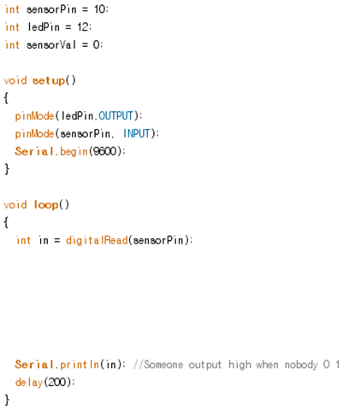
Code Example - PIR Sensor
Detect a person using PIR
Turn on the led during 1s when PIR sensor detects person

Slide 19
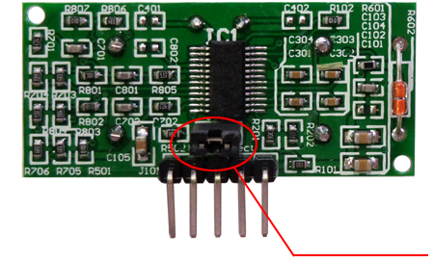
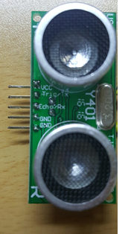
Ultrasonic Sensor
How to use a Ultrasonic sensor
Step 1: connect the sensor to Arduino
Voltage : 5v
Step 2: remove the cap in the backward
It makes that ultrasonic sensor operating Echo/Trigger mode.
Step 3: Turn on the Arduino
Attention : you have to connect the sensor to Arduino
Step 4: Checking detection result
Tools -> Serial Monitor
Echo/Trigger mode
Voltage
Trigger
Echo
GND

Slide 20
Ultrasonic Sensor Datasheet
Specifications
Input voltage: 5V DC
Quiescent current: less than 2mA
Level output: 5V high
Level output: at the end of 0V
Induction angle: not more than 15 degrees
Detection distance: 2cm - 450cm
Precision: up to 1mm
Dimensions: 4.4cm x 2.6cm x 1.4cm
Weight: 43g

Slide 21
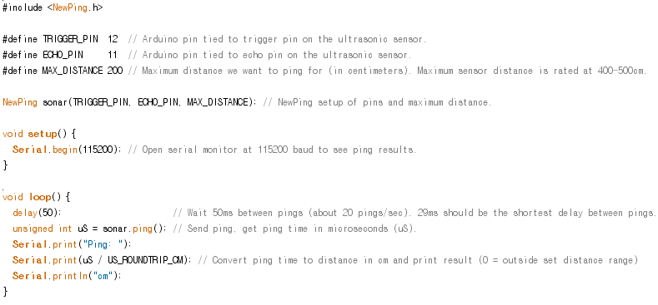
Ultrasonic sensor Code example

Slide 22
Practice

Slide 23
Practice #1
Find a distance between ultrasonic sensor and you
Step 1: Connect sensors to the bread board
Step 2: When you click the button, detects a person using PIR sensor
Step 3: When PIR sensor detects a person then shows distance between sensor and you

Slide 24
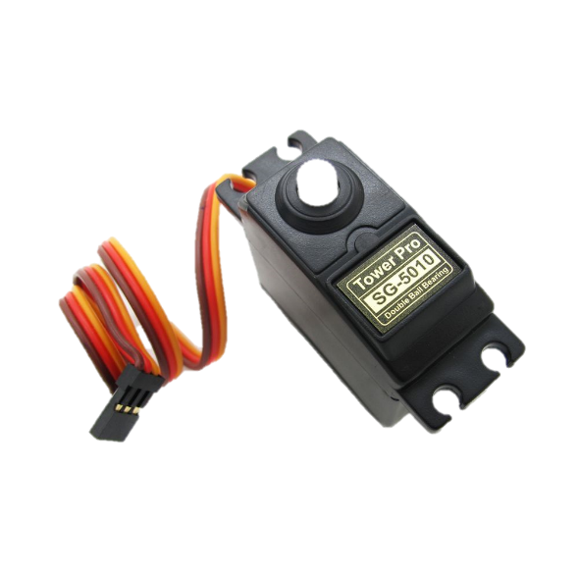
Practice #2
Make a Sonar radar with ultrasonic and motor
Servo motor → Tower Pro SG-5010
https://www.arduino.cc/en/Tutorial/Sweep
Rotate 360 degree left and right

